Slide 1

IMMO ELIZA PROJECT
PRESENTATION
PART II

Slide 2

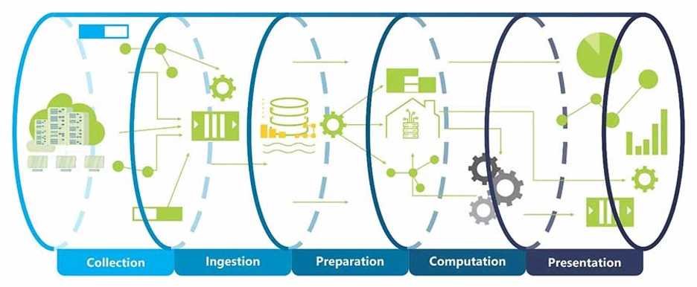
OUR
PROJECT CONTINUED

Slide 3
OUR
PROJECT CONTINUED
3 variables removed
Too many “nones”.
15 columns,
3 removed
Types of graphs
Mostly histograms due to nature of data.
4 quantitative,
8 qualitative variables
Data cleaning
Data analysis
Visuals
OUTPUT
INPUT
Province repartition
Each team member analyzed data for 2 or 3 provinces. Visuals could be made for the subchoice or the entire dataset.

Slide 4
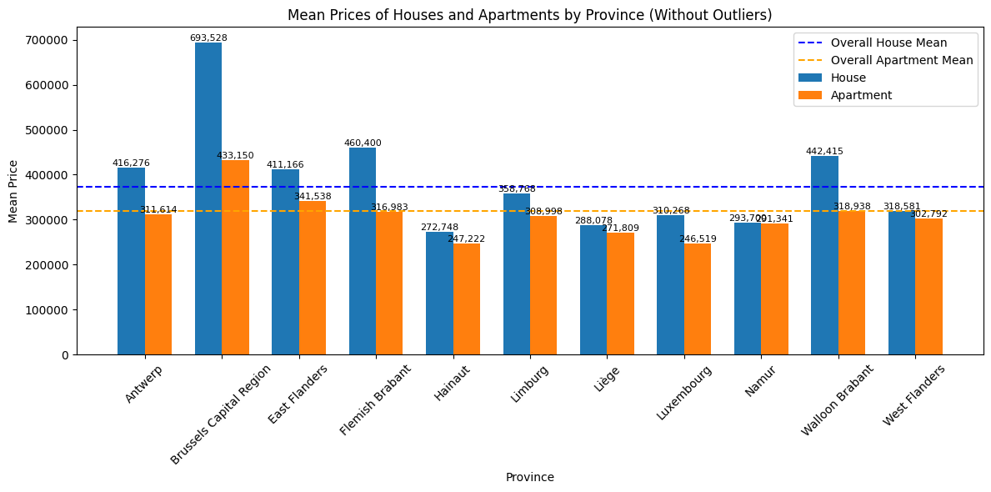
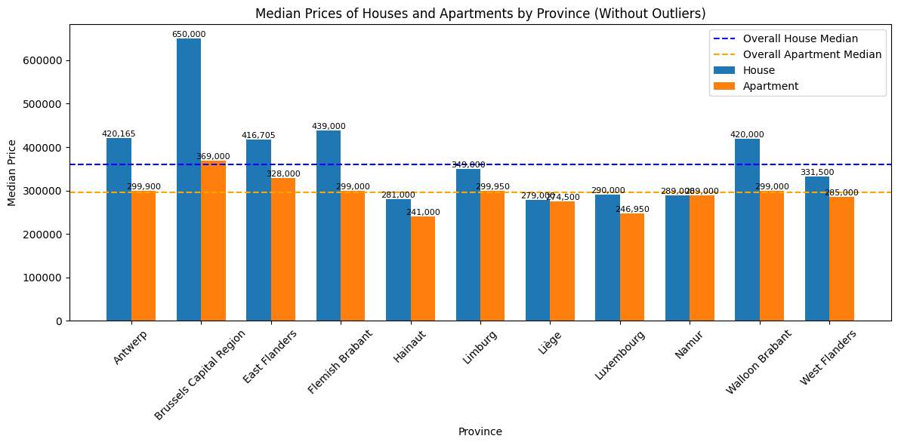
OUR
RESULTS

Slide 5
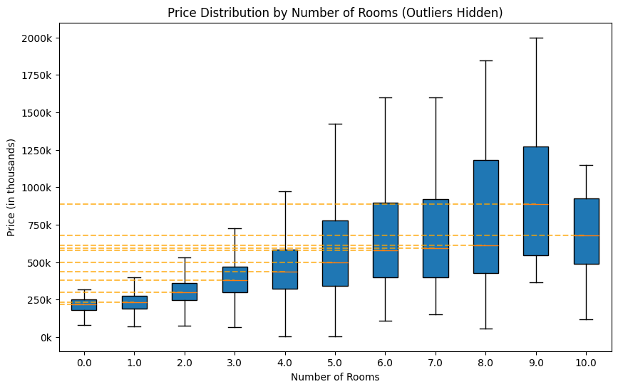
OUR
RESULTS

Slide 6
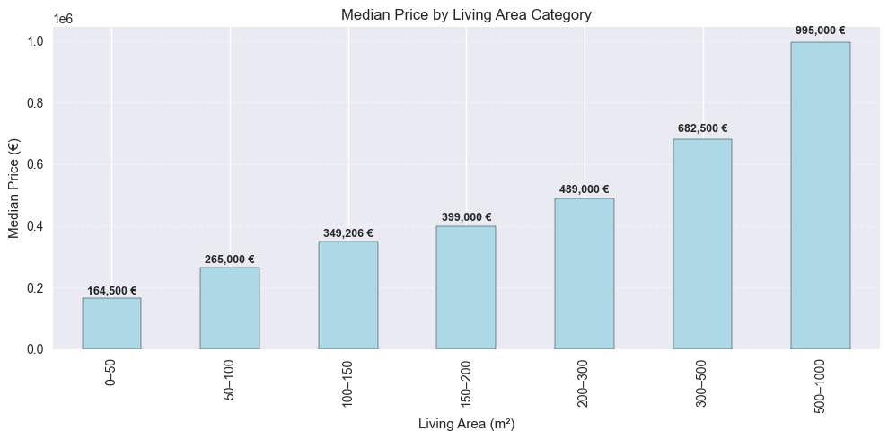
OUR
RESULTS

Slide 7
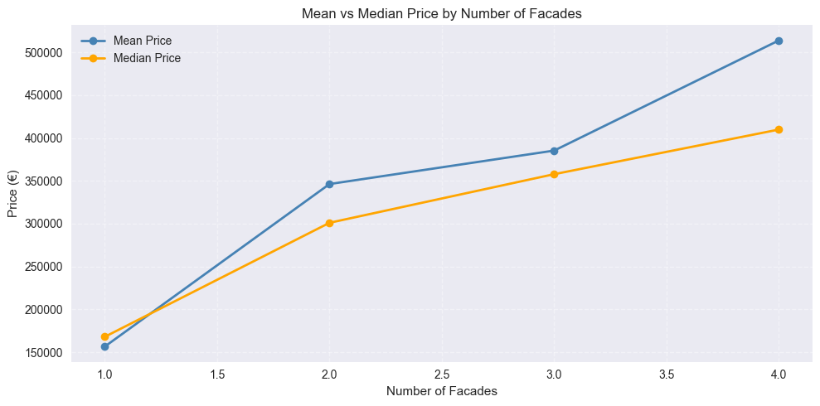
OUR
RESULTS

Slide 8

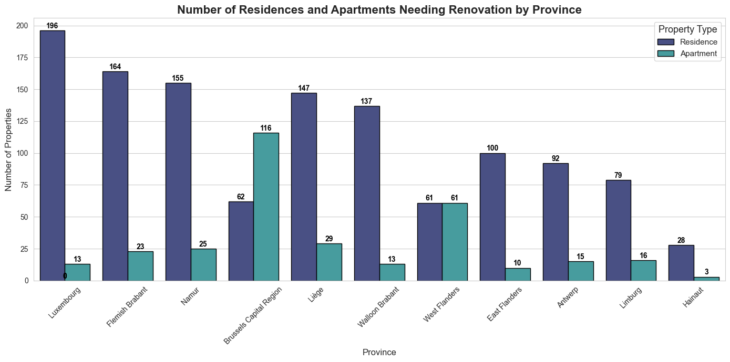
OUR
RESULTS

Slide 9
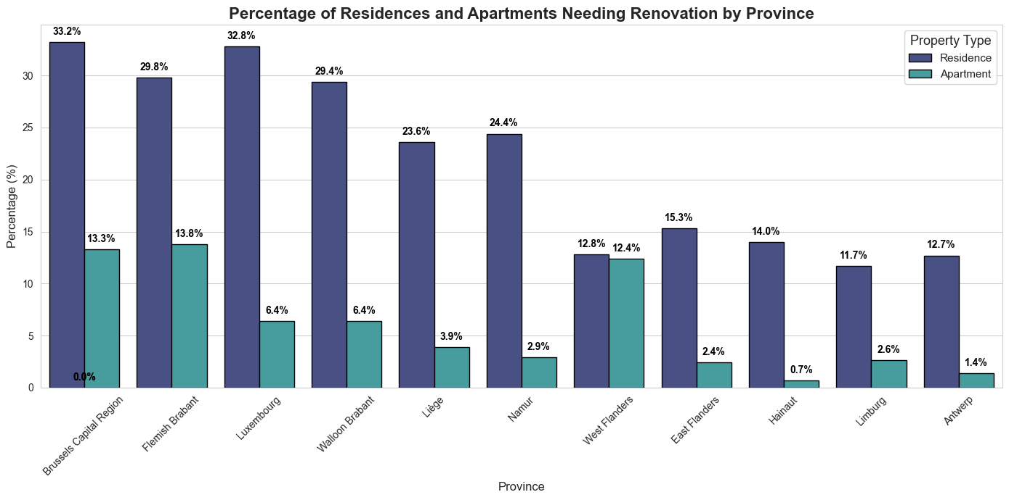
OUR
RESULTS

Slide 10
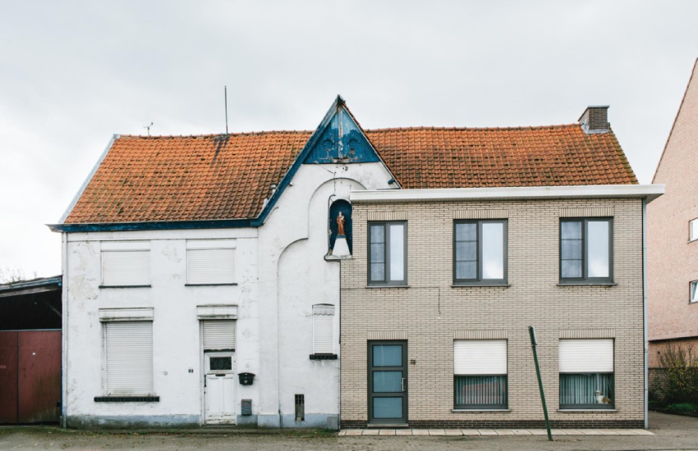
OUR
RESULTS

Slide 11
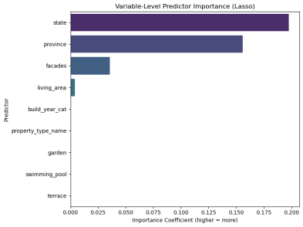
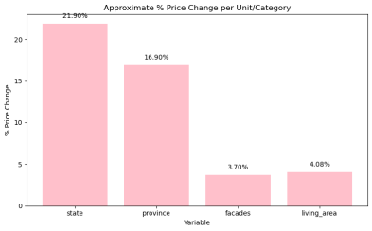
OUR
RESULTS

Slide 12

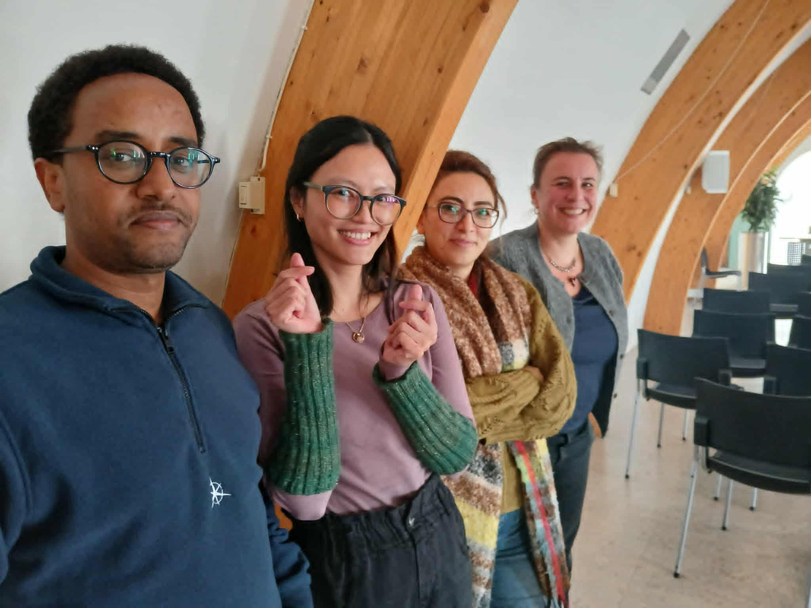
MEET OUR
TEAM MEMBERS
Welederufeal Tadege, Hamideh Baggali, Intan K. Wardhani, Sandrine Herbelet

Slide 13

THANK YOU
VISIT US
https://www.linkedin.com/in/sandrineherbelet/
https://www.linkedin.com/in/welederufeal-t-027907a5/
https://www.linkedin.com/in/hamideh-be/

